Slide 1

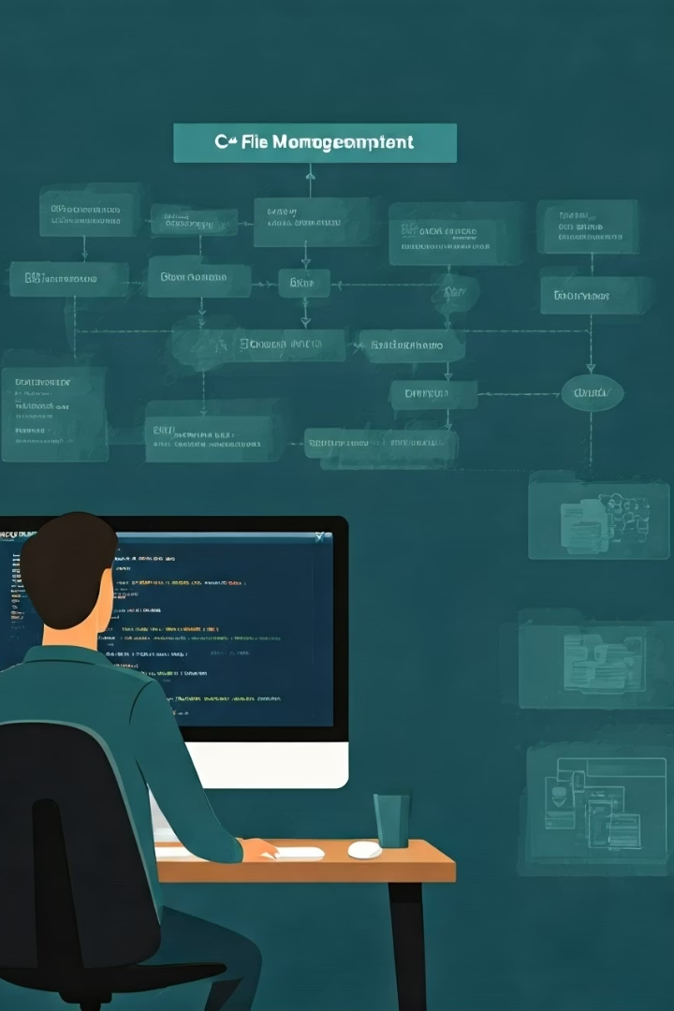
File Management System in C++
Efficient, Secure & Organized File Handling
Developed by Chaitanya Gaba, Swastik, Karan, and Mitanshu.
by Team ByteBros
Notes:
1

Slide 2

Problem Statement & Objective
Problem
Traditional file handling is error-prone and unstructured.
Objective
Enable secure, scalable, and organized file operations with search and sorting.
Notes:
2

Slide 3
System Architecture
User Interface
File Operations
Search & Security
Storage Management
Command-line interface for user interaction and navigation.
Handles creation, reading, updating, and deleting files efficiently.
Facilitates fast searches with file encryption for protection.
Organizes physical storage ensuring scalability and integrity.
Notes:
3

Slide 4


Frontend & Backend Overview
Frontend
Backend
Command-line interface
C++ based file input/output handling
Supports file search and sorting options
Implements encryption for security
Notes:
4

Slide 5
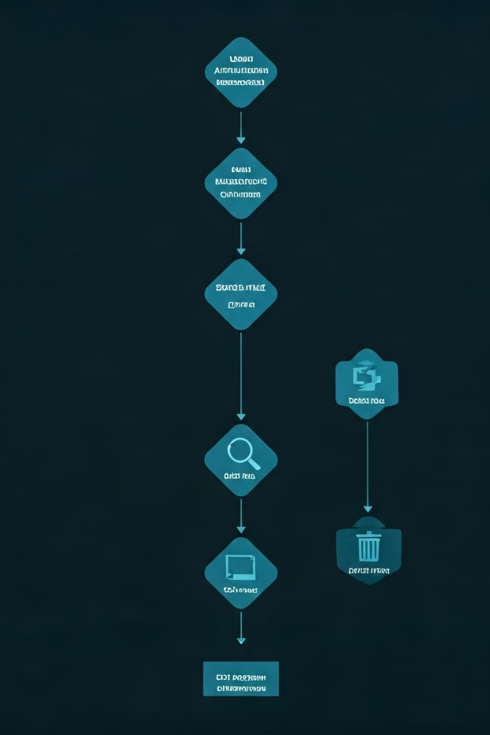
Process Flowchart
1
User Authentication
2
Main Menu
Secure login to access the system
Select actions: Add, Search, Delete, Exit
3
File Operations
Perform requested file management tasks
Notes:
5

Slide 6
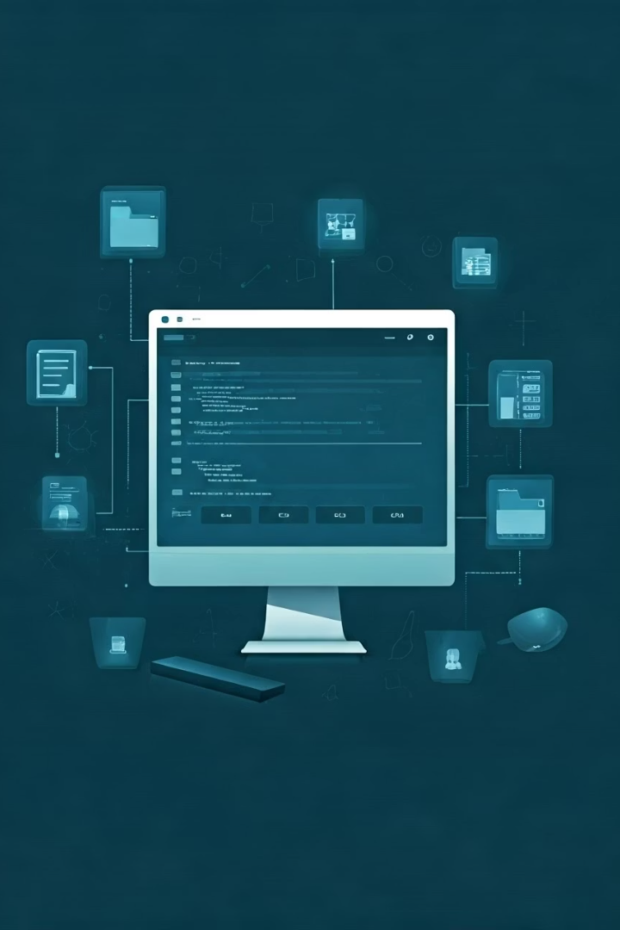




Use Cases
Students
Professionals
Organizations
Organize notes and assignments securely
Manage projects and confidential documents efficiently
Scale file handling across departments securely
General Users
Keep personal files sorted and easy to find
Notes:
6

Slide 7
Team Roles
Name
Role
Responsibilities
Chaitanya Gaba
Utils.h, Response.h & Search.h
Function that streamline various operations like search, error messages
Swastik Adhikary
Read.h, Encryption.h & Delet.h
File retrieval, encryption, removal
Karan Joshi
Size.h & Edit.h
Manages size allocation, file edition
Mitanshu Garg
Tester & Documentation
Testing workflows and maintaining system documentation
Notes:
7

Slide 8


Conclusion & Future Scope
Summary
1
Future Plans
Efficient, secure, and simple file management
2
Develop GUI, cloud integration, AI features, and mobile support
Notes:
8

